Slide 1
From across the US and abroad
700 + members
High Schools + 2-Year Schools + 4-Year Schools + Employers

Slide 2
Web-based Knowledge Zone
Direct engagement with a large group of EL professionals (distance or in-person)
Regularly updated blog
Opportunities to get involved – in large ways and small
Webinar series
Annual conference (300-400 attendees)
Chicago in 2019 + San Diego in 2020

Slide 3
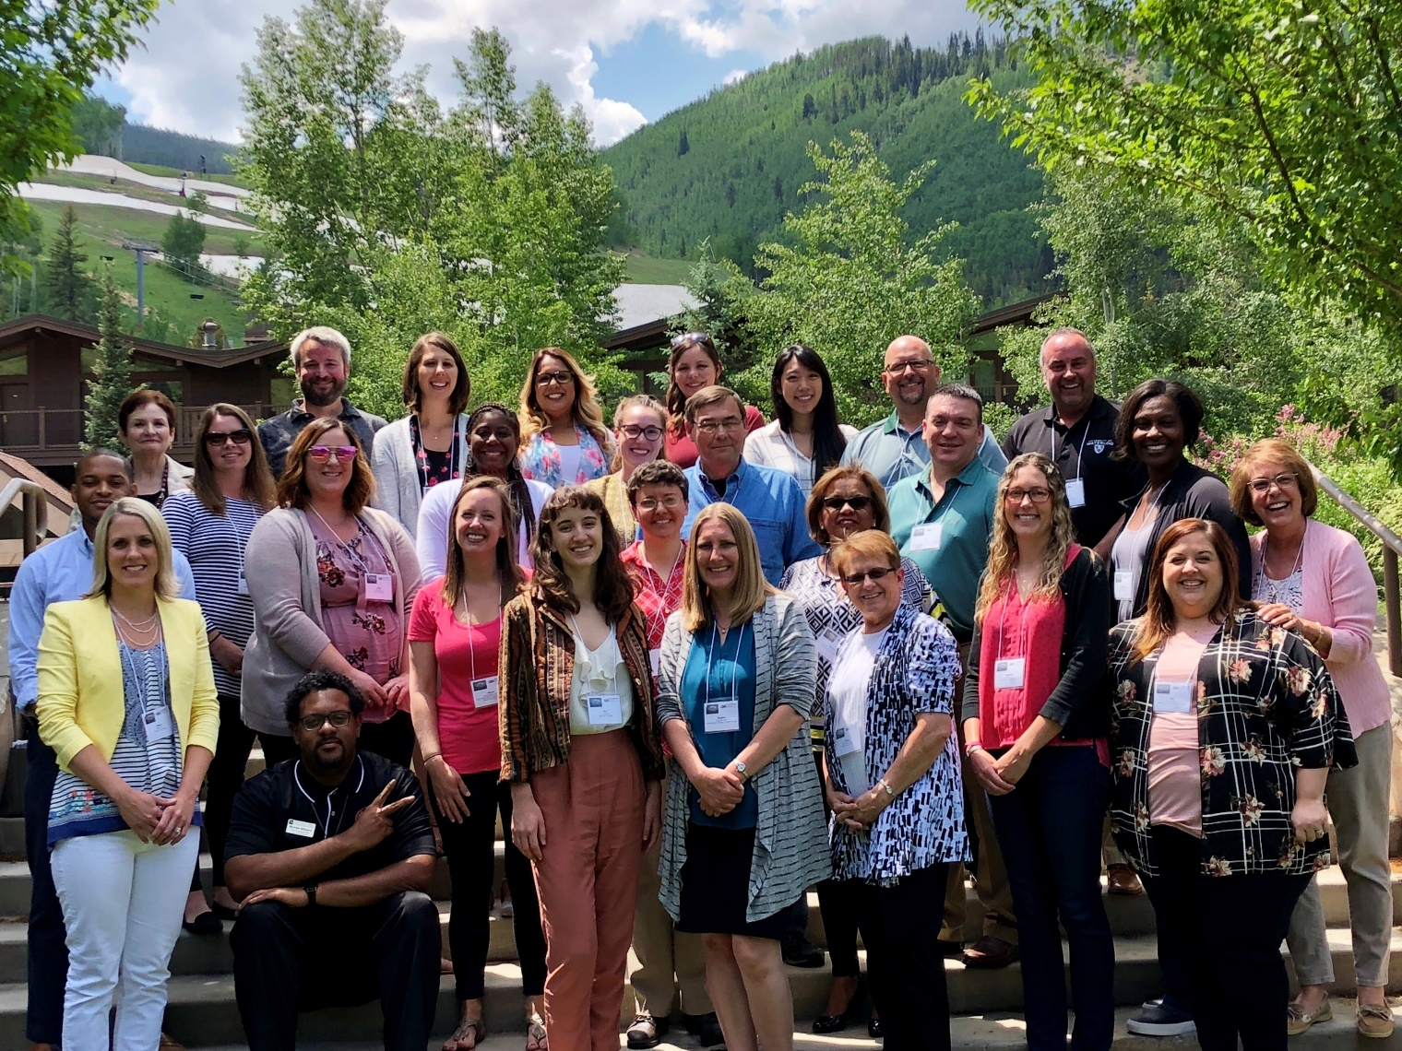
Are you new to experiential learning?
Know someone who is?
Check out CEIA Academy!
3 day training event
Capped around 25 attendees
Outcomes-focused
Highly interactive
11-13.June.2019 – Vail, Colorado

Slide 4
Local contact
- Zach Osborne
- Director of Internships, Career Services, and Study Abroad at Menlo College
- Vice President of Region 7, which includes California
- 650.543.4097
- zach.osborne@menlo.edu
For more info, refer to the CEIA card in your materials and check out the website: www.ceiainc.org!

