Slide 1


Coworking and Community Colleges - Partners for Innovative Internships in the Gig Economy
CIWEA
02 November 2018

Slide 2
Outline
My background (keep this extra short)
Overview of Mountain Lab
What is an entrepreneurial ecosystem?
Different ESOs: coworking, makerspaces, incubators, accelerators, traditional office space, corporate offices
How can entrepreneurial thinking help students?
How can it help institutions?
Using the business model canvas to practice the E.M.

Slide 3

The Team
Dr. Jamie Orr, Co-founder, Tahoe Mountain Lab
Cornelius Brown, DSN Small Business, Greater Sacramento Region
Brad Deeds, Dean of Workforce Development & Instruction, LTCC
Amber Goligoski, Program Coordinator for Work-based Learning, LTCC

Slide 4
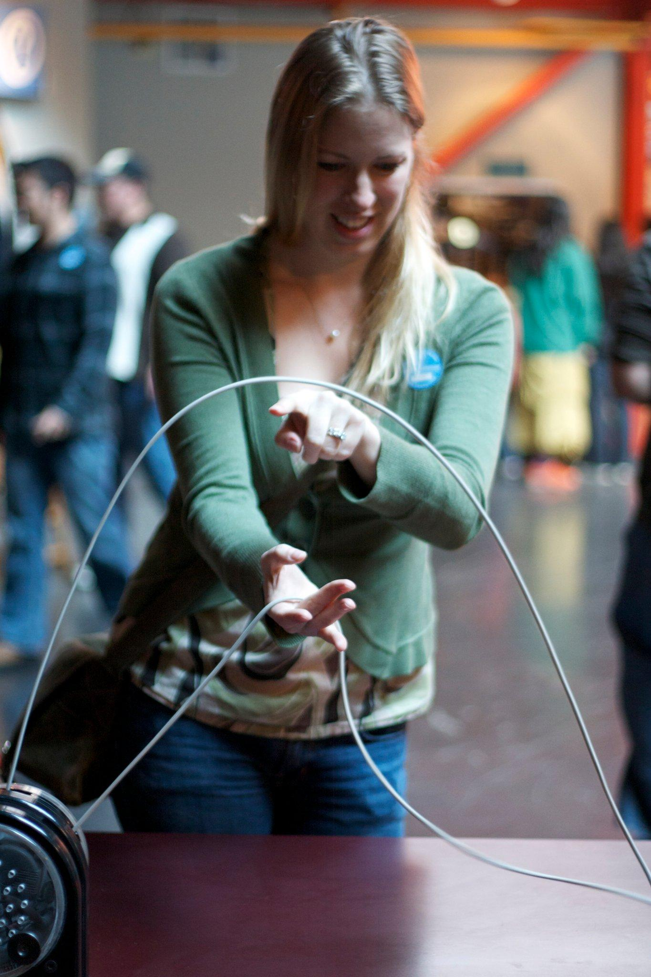

My Story in a Nutshell

Slide 5







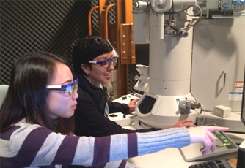

Solid Lines: Covalent Bonds
J.W. Ponder and D.A. Case. Adv. Prot. Chem. 66, 27-85 (2003).

Slide 6
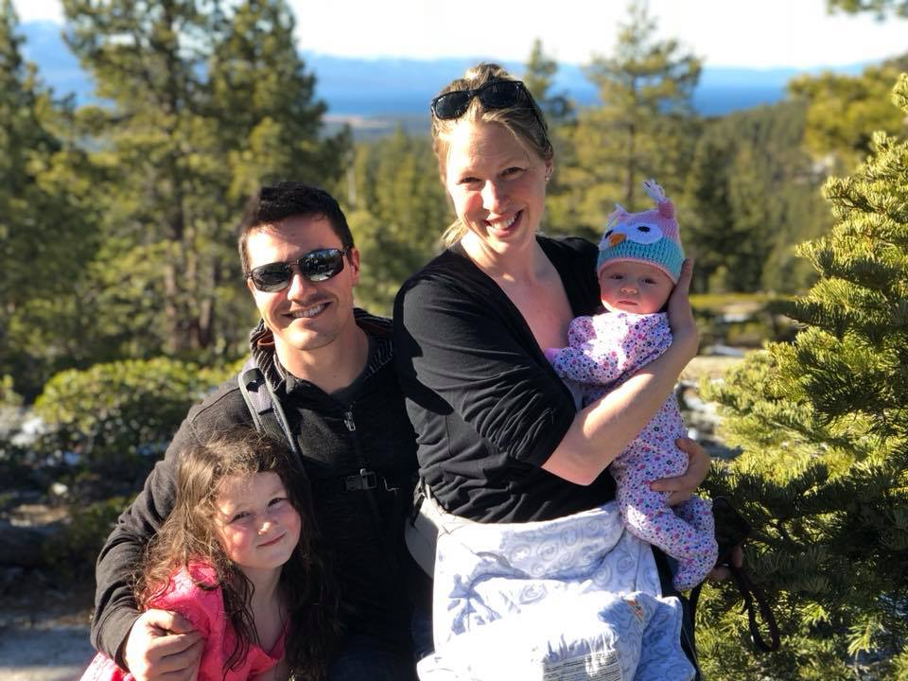
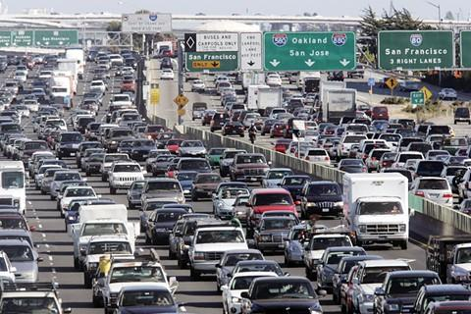
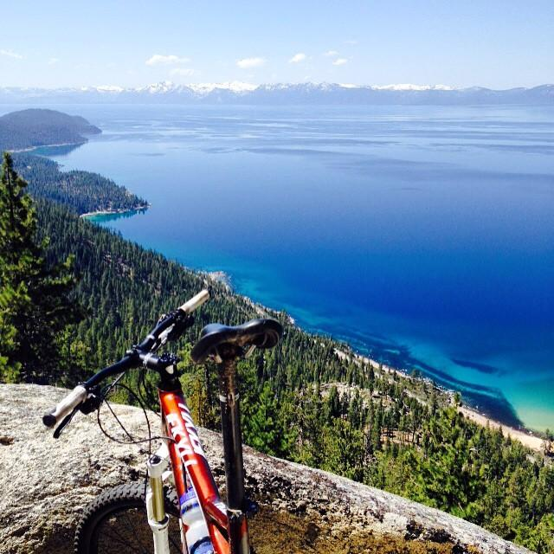

Slide 7
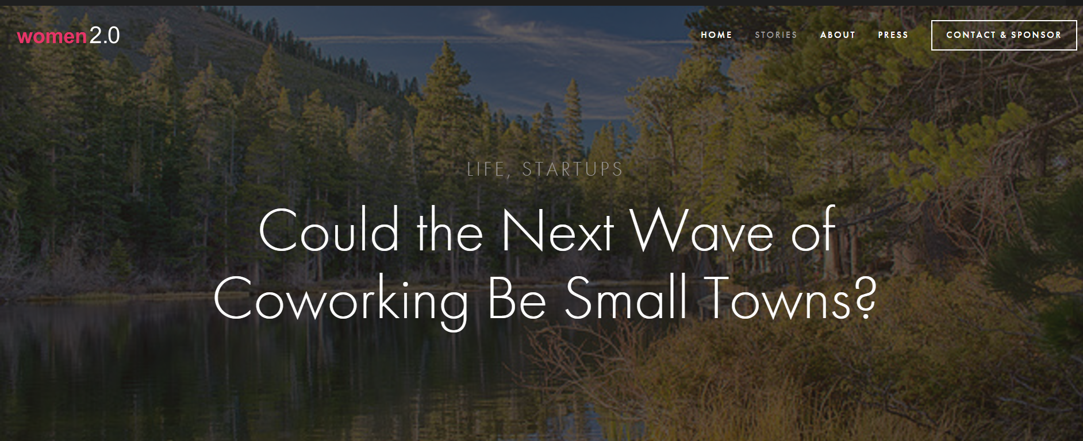

Slide 8
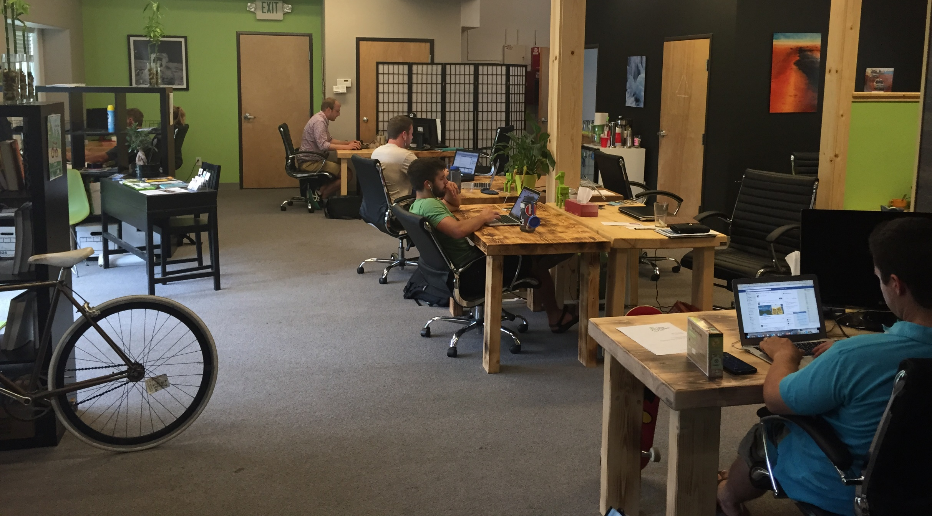
Tahoe Mountain Lab 1.0

Slide 9
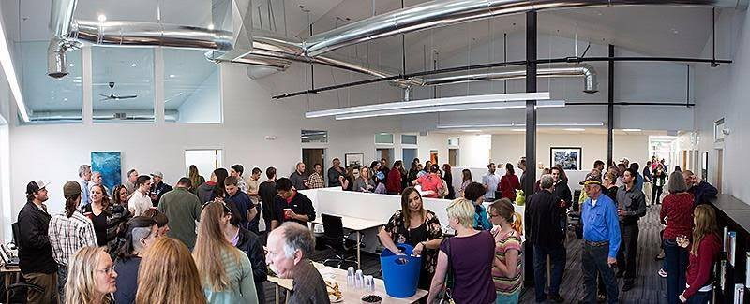
- “2.0”
Notes:
For my Daughters 2nd birthday November of 2013 we announced to my friends and family that we were moving to Tahoe……
We had no plan….
We attempted to quit our jobs…
In December 2013 we moved into our home in Tahoe…

Slide 10
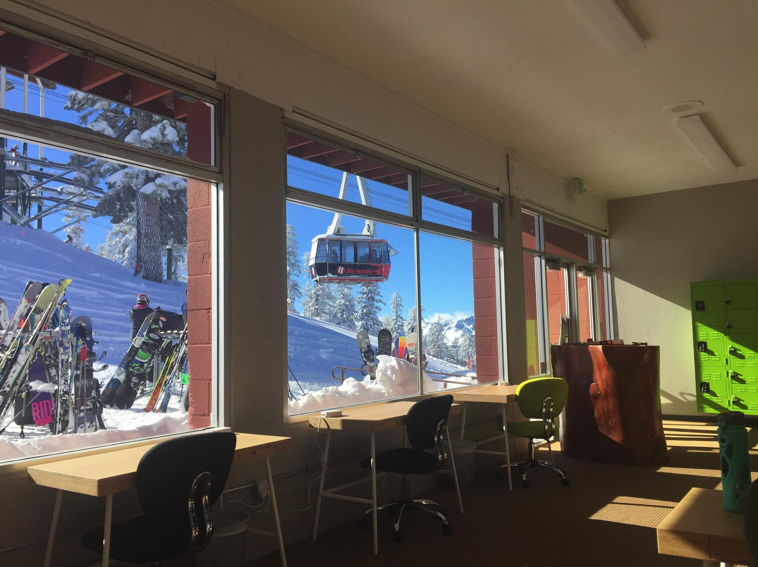
Mountain Lab “2.5” @ Heavenly

Slide 11



























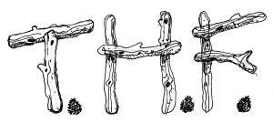













LEVEL Frames

Slide 12
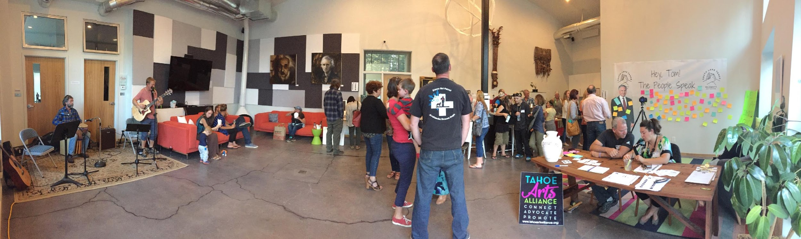
A Community Center for Innovation

Slide 13
The whole is greater than the sum of its parts
Aristotle
Notes:
My guiding principle and why silos don’t work.

Slide 14

What is an ecosystem?
“a complex network or interconnected system”
Modification
Action
Reaction
Copyright (c) 2004 Richard Ling www.rling.com

Slide 15
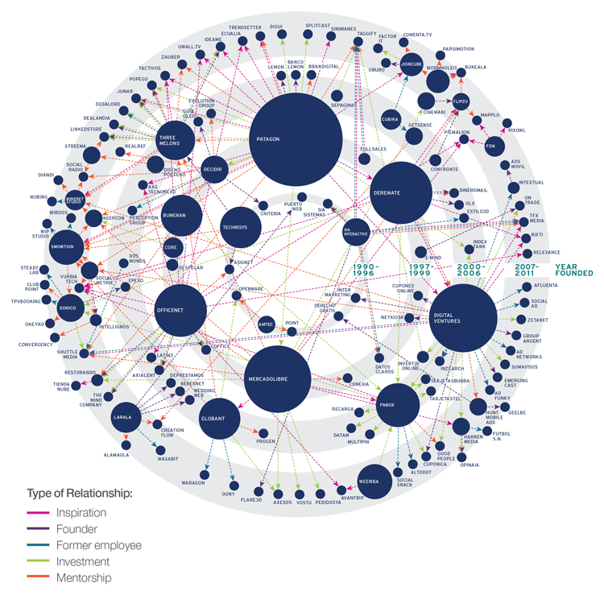
What is an entrepreneurial ecosystem???

Slide 16
Entrepreneurial Ecosystems encourage entrepreneurs to:
Connect
Collaborate
Mentor

Slide 17
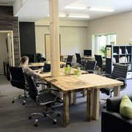
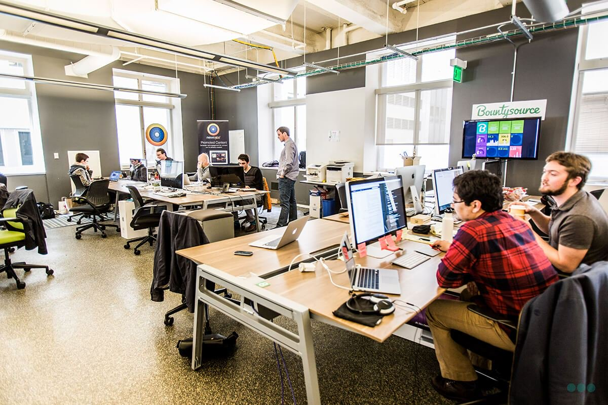
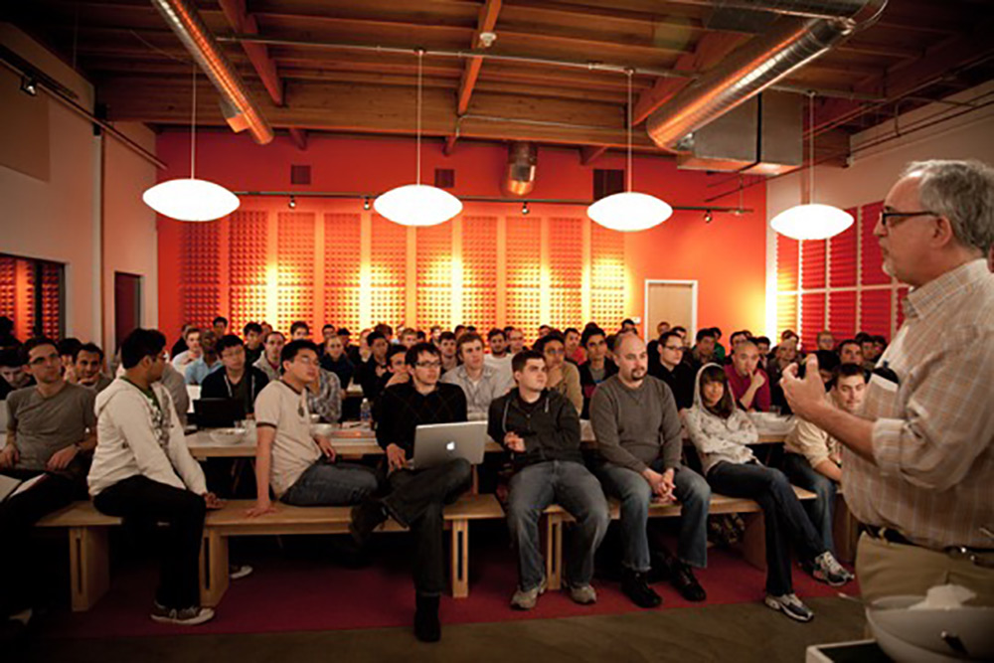
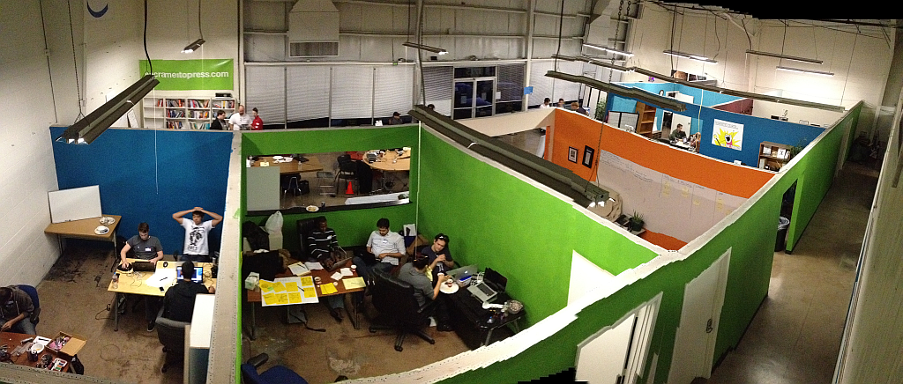
Coworking Spaces
Incubators
Accelerators
Makerspaces

Slide 18
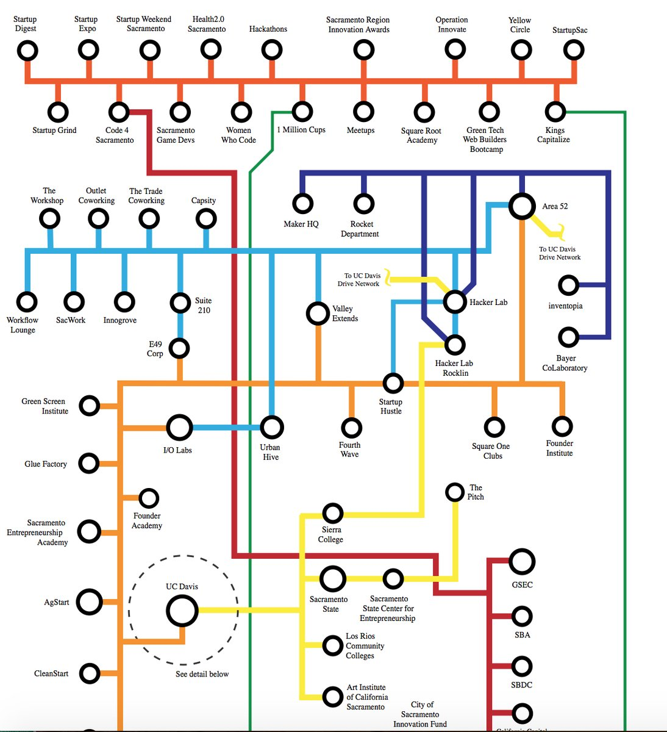
Sacramento Startup & Innovation Ecosystem Diagram
http://startupsac.com/sse/

Slide 19

How can entrepreneurial ecosystems benefit college communities?
Notes:
Introduce quantum mechanics of states here.

Slide 20
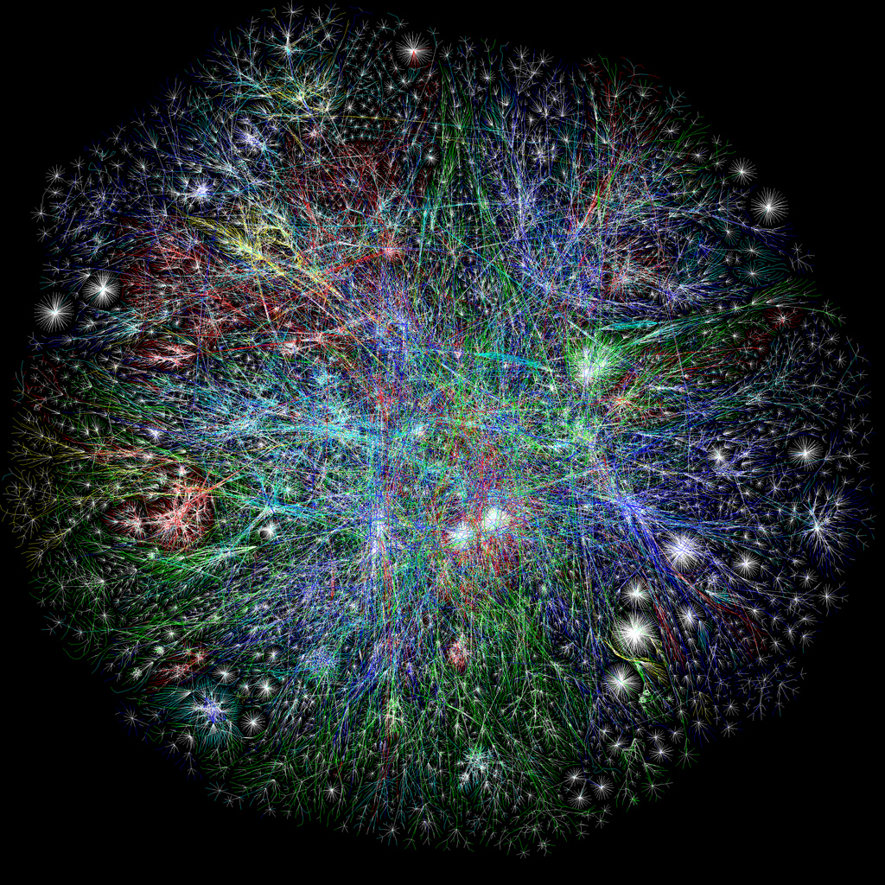
Entrepreneurial Thinking
Challenges are opportunities.
Everything requires effort.
Perfection is the enemy of progress.
Mistakes are healthy.
There is no magic.
Outside perspective is invaluable.
Discipline is a prerequisite.

Slide 21
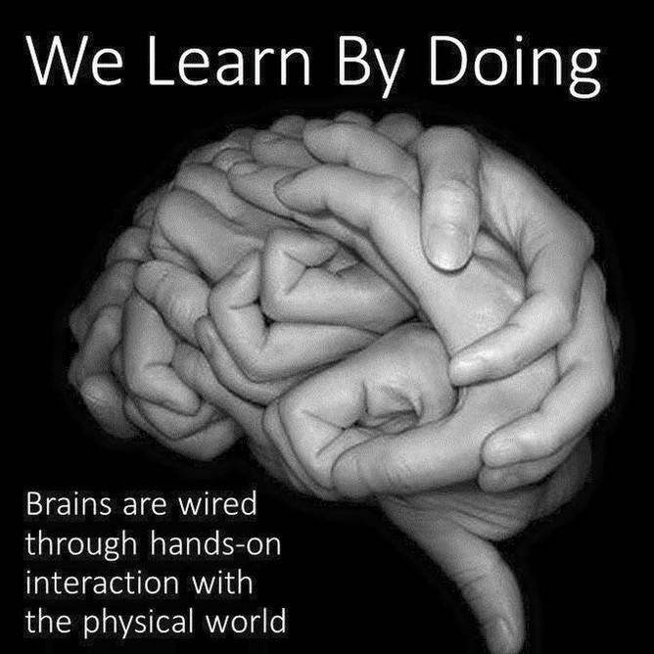
The Entrepreneurship Skill Set
Notes:
Teamwork
Creativity
Financial Stability
Best learned through experience
Environments, not courses.

Slide 22
“We need to prepare students differently for what their post-college lives are going to look like.
Entrepreneurship is a really, really powerful way of developing the life and professional skills needed to excel in the 21st century.”
~Neil Kane, Michigan State U.
Notes:
An experienced entrepreneur and business executive named a “Technology Pioneer” by the World Economic Forum, Neil Kane points to stats that say 40 percent of students who start college now will at some point during their careers be self-employed.

Slide 23
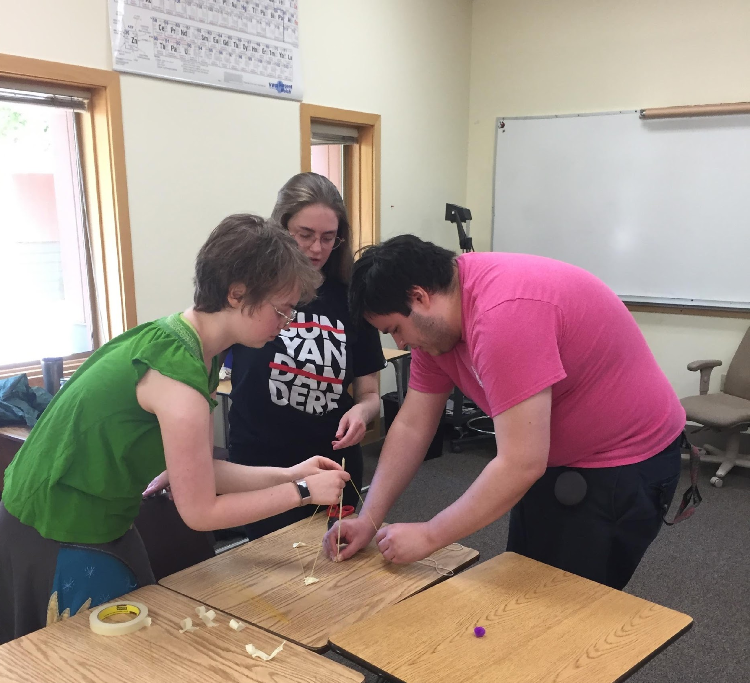
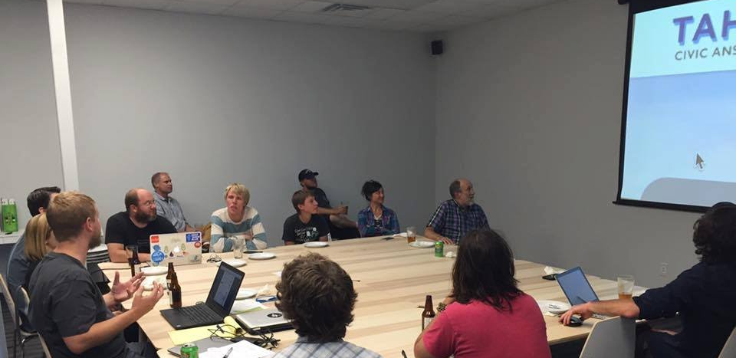
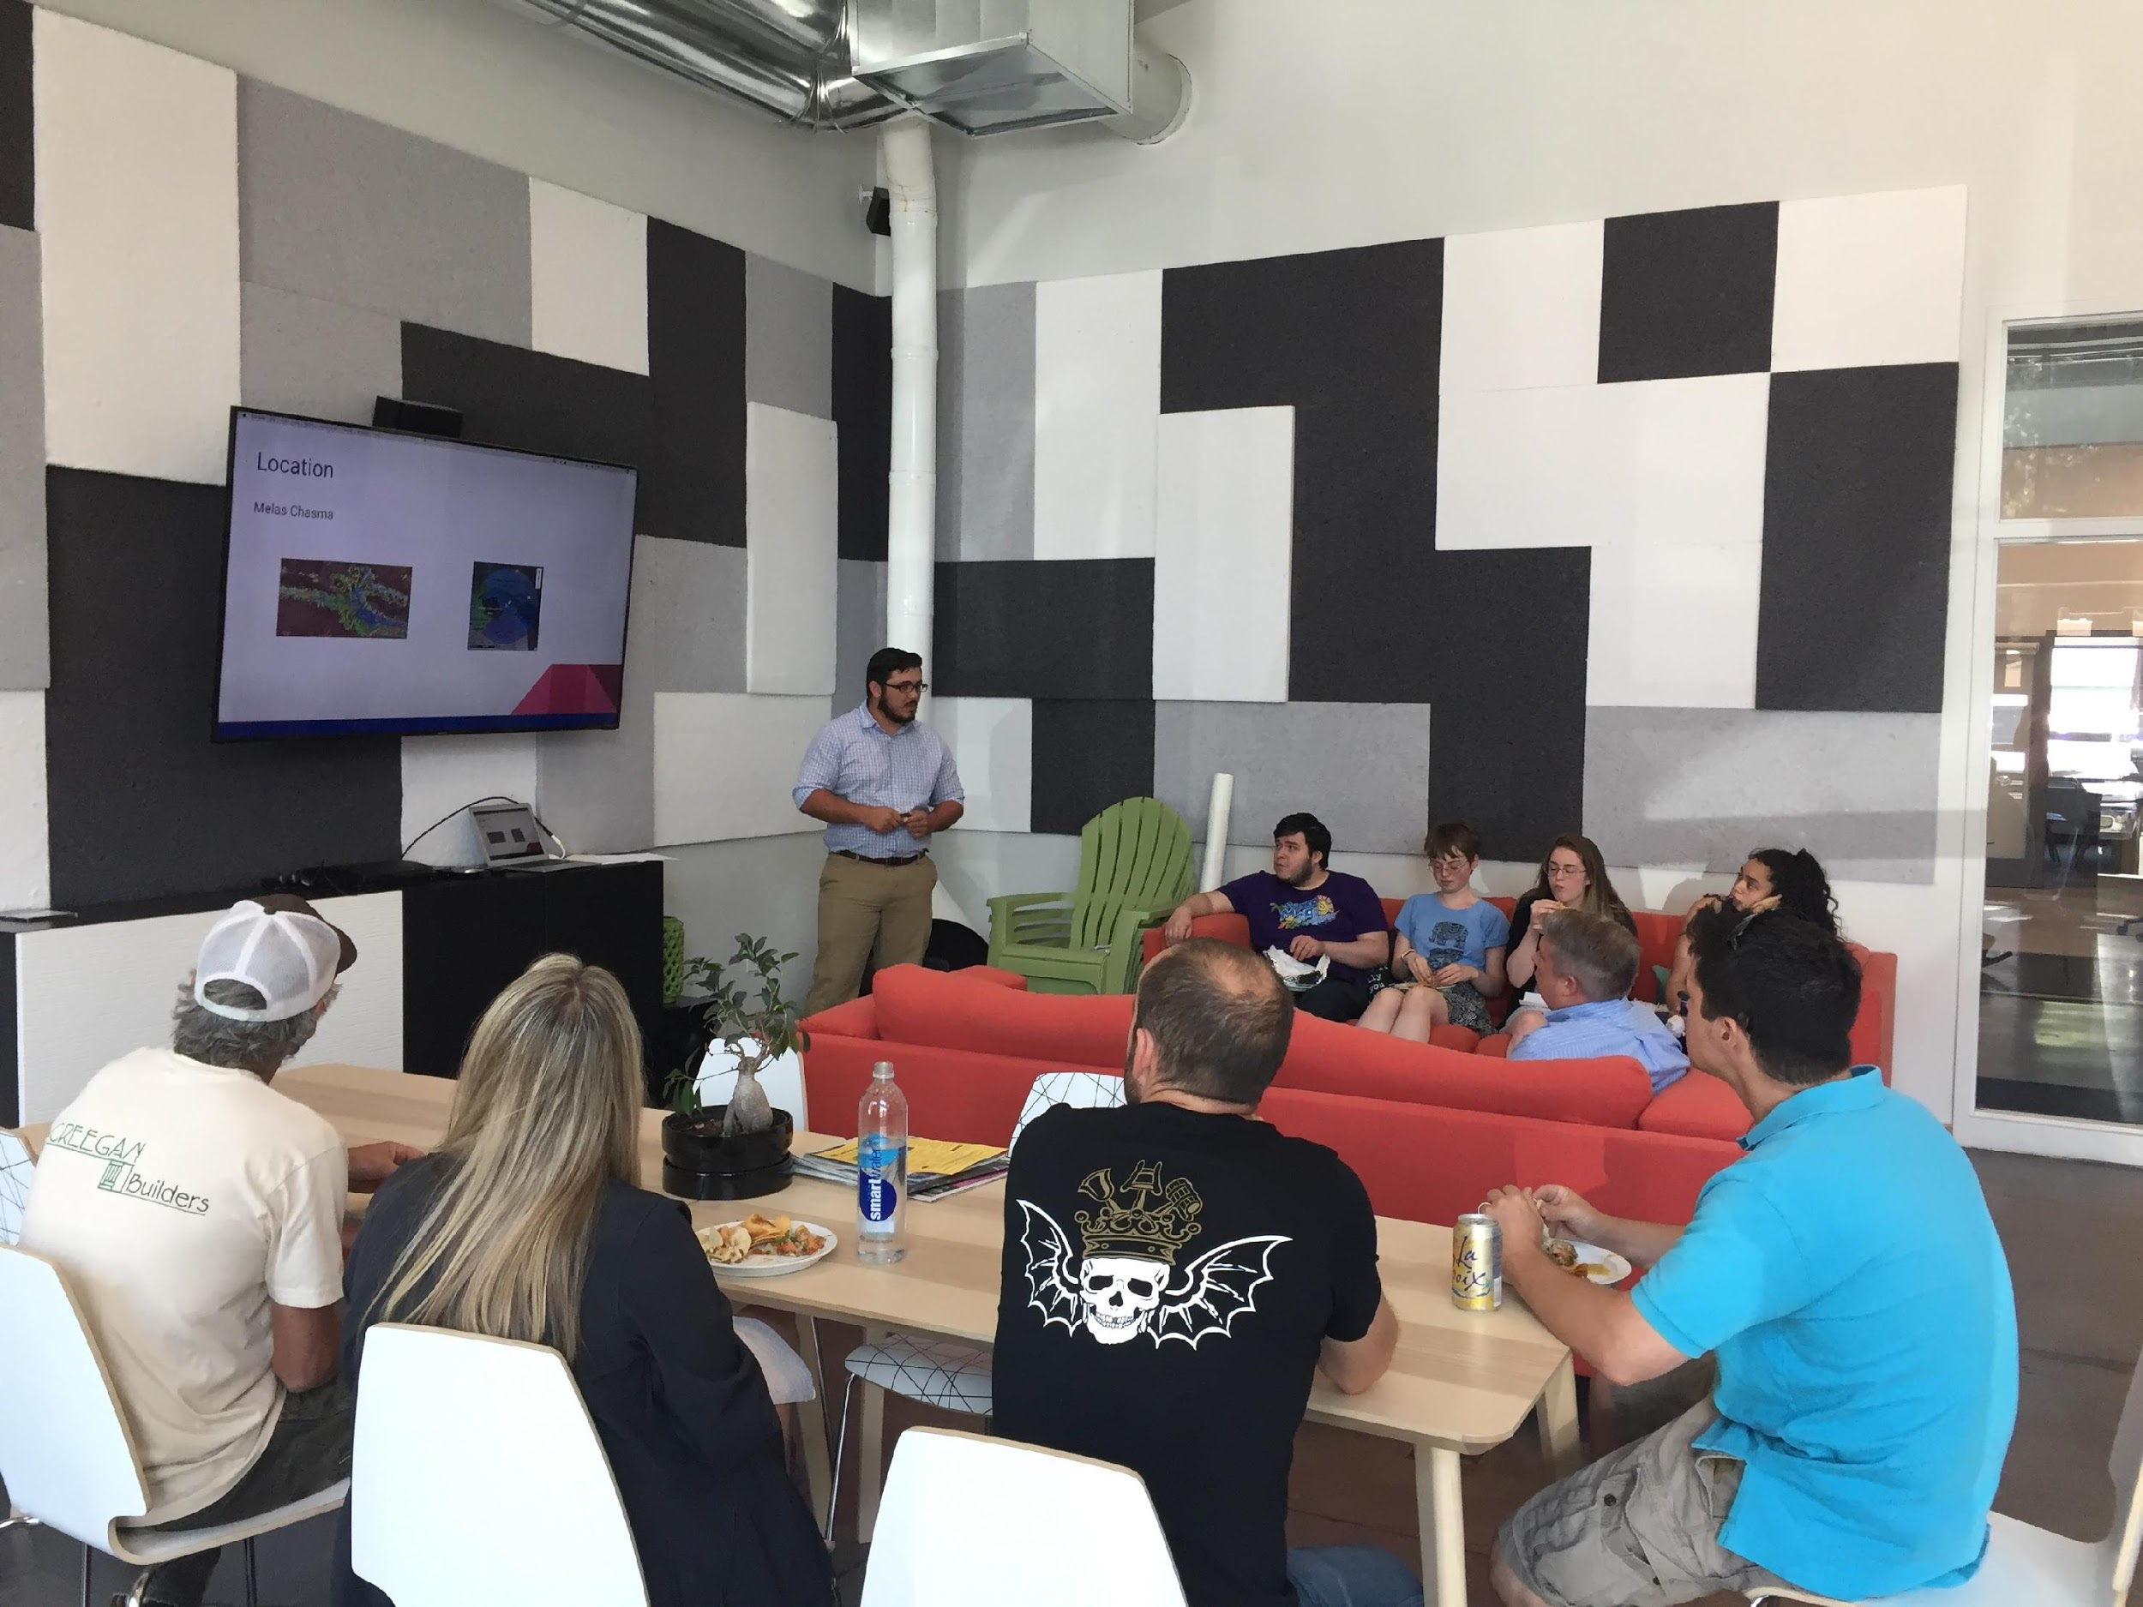

Internships @ Mountain Lab
Entrepreneurship is for more than business students.
Notes:
An experienced entrepreneur and business executive named a “Technology Pioneer” by the World Economic Forum, Neil Kane points to stats that say 40 percent of students who start college now will at some point during their careers be self-employed.

Slide 24
LEVEL Frames

Slide 25

Entrepreneurship is for more than just students.
Notes:
Leveraging Entrepreneurial Thinking for Institutional Change in Academic settings
Using E.M. techniques to build programs, pivot, and stay relevant in the 21st century economy for the benefit of our student populations

Slide 26

Entrepreneurship helps us take control of our own destiny.

